Slide 1

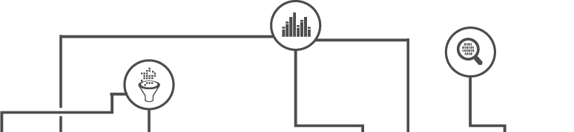

Towards Automatic Context Inference
for Sensors in Commercial Buildings

Slide 2






Notes:
People spend 93% of time indoors and providing a comfortable env can improve 8-11% productivity.
To ensure\\ that these buildings operate normally and are comfortable throughout diff weather conditions,
we need to assess and control various factors\\, such as air circulation, heat flow, moist. lv, or lgt cond.
To this end, 1000s of sensors are installed to monitor the speed of every fan, status of every water pipe, and the kw consumption of every circuit,\\

Slide 3
Maintenance
Comfort
Correctness
Zone Temp 2 RMI204
Temp Floor 1 Area1
SODA1R300__ART
SODA1R410B_ART
Notes:
On top of these sensors, nuanced intelligent analytics are running continuously\\
to optimize the comfort\\ assure the correctness\\ identify faulty and dysfunctional equip.
As an example, an analytics that detects overheated rooms would need to locate and pull data from the tmp & tmp stpt in each room\\
Such contextual information about the type and location of sensors is extracted from their point names, e.g., in bldg1\\ another two look completely diff\\
Diff buildings use diff naming vocabularies and conventions

Slide 4
Maintenance
Comfort
Correctness
Maintenance
Comfort
Correctness
Metadata Mapping
Zone Temp 2 RMI204
Temp Floor 1 Area1
SODA1R300__ART
SODA1R410B_ART
Notes:
Consequently, as a first step in running analytics\\, we need to create a match btw the data streams and the inputs of AE\\
This process is called metadata mapping and is currently a manual process performed on a per building basis

Slide 5



SODA1R300__ART
Bldg: xxx
Zone: xxx
Room: xxx
Type: xxx
SOD
1
300
Room Temperature
EIA's 2012 Commercial Buildings Energy Consumption Survey
Notes:
As an example, here you see\\ a technician with domain knowledge needs to manually segment the piont nemsand decode the information\\
It takes weeks for a typical bldg with thousands of sensors&points\\not scalable
Mapping one bldg could be 1M business\\ >savings, eat into benefits

Slide 6
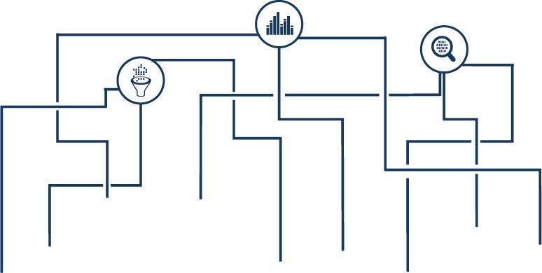



Maintenance
Comfort
Correctness
Context
Schema
Toolkit
Metadata
Mapping
Type Inference
Relation Inference
Plaster
Notes:
My dissertation work tries to tackle this metadata mapping problem by proposing new methods that automatically extract type and relations\\
and providing a tool to express this information in a uniform format

Slide 7

Maintenance
Comfort
Correctness
Context
Schema
Toolkit
Metadata
Mapping
Type Inference
Relation Inference
Plaster
Notes:
To summarize, contributions b4 and after proposal.

Slide 8
Sensor context can be inferred using names and data with minimal or no manual effort
Hypothesis
Notes:
PAUSE

Slide 9
Maintenance
Comfort
Correctness
Context
Schema
Toolkit
Metadata
Mapping
Type Inference
Relation Inference
Plaster

Slide 10














1
SODA-ZONE2ART
SODA2R214_ART
SODA1R300_ART
Zone1 Temp RMI328
Space RMI530 TMP
DA Humiditydac4UIP17
SODA-AHU9-SFS
SODA3AHU7-SFS
Notes:
given names and data, the goal is to automatically predict the types\\
we usually have well mapped bldgs; the challenge however, is how to transfer the info\\
On the one hand, pt name is a good indicator of the type, but the pattern does not generalize across buildings\\;
On the other hand, TS data is more likely to be similar between buildings, e.g., temp is 60-70 no matter which building\\
so we transfer the info in data by training a clf using data features\\ and apply the clf in the new bldg to predict types

Slide 11


2
1
SODA-ZONE2ART
SODA2R214_ART
SODA1R300_ART
SODA-AHU9-SFS
SODA3AHU7-SFS
Notes:
we can train a different clf to learn a different perspective of the data feautres

Slide 12

3
1
2
SODA-ZONE2ART
SODA2R214_ART
SODA1R300_ART
SODA-AHU9-SFS
SODA3AHU7-SFS
Notes:
and similarly a third

Slide 13
1
2
3
0.67
0.33
0.67
SODA-ZONE2ART
SODA2R214_ART
SODA1R300_ART
SODA-AHU9-SFS
SODA3AHU7-SFS
Notes:
however, each clf can give a different prediction, how to effectively adopt the preds?
people tend to name the same type of sensors similarly\\, so we look at how much the clf's preds agree with the name clusters, in order to quantify a clf's confidence
e.g., we cluster names and get 2 groups, we see that out of the 3 sensors\\, 2 are predicted as temps -- thus 2/3 = 0.67\\ we do so for each clf and take a weighted sum
Also set a threshold to assure confident preds

Slide 14
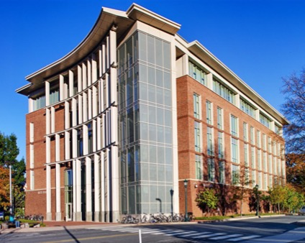
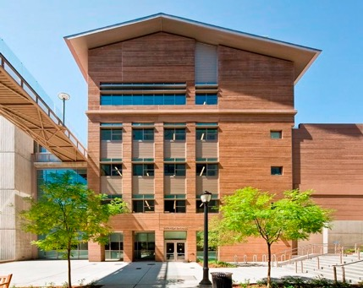
Evaluation Dataset
3 buildings on 2 campuses
2,500+ sensing and control points
22 types
A: Rice Hall
B: Soda Hall
C: Sutardja Dai Hall

Slide 15
Type Classification Accuracy by Transfer Learning
Cov: % labeled
Acc: % of labels are correct
Notes:
x-axis: threshold
metrics, two-way transfer
trend: as acc goes up, cov goes down
mention the numbers:96acc/72cov 85acc/92cov

Slide 16
Related Work
Schumann et al. - BuildSys’14
Bhattacharya et al. - BuildSys’15
Balaji et al. - BuildSys’15
Gao et al. - BuildSys’15
Koh et al. - BuildSys’18
-Still require manual effort
-Work within a building

Slide 17






Follow-up work on Type Inference
?
Transfer Learning
?
?
lux
lux
?
?
?
Fully Automated Transfer Learning (this work)
Semi-Automated Active Learning
Active Learning
Notes:
BA can automatically predict the type for a fraction of points,\\ some still remain unlabeled.
We still need human input\\ and resort to AL to reduce the #human input

Slide 18
Clustering-based Active Learning
Zone2 TMP RMI204
Temperature
Temperature
?
?
Zone3 TMP RMI120
Temperature
?
Zone4 TMP RMI530
Humidity
?
Humidity
?
Zone2 TMP RMI228
Zone4 HUM RMI 2014
?
Humidity
?
RMI328 HUM
RMC104 HUMID
Humidity
Notes:
As human input is costly, we want to predict the type using the minimal #human effort\\
Challenge: how to select the best examples for a human to label and train a clf?
Intuition: names of same type of sensors tend to be similar\\, so only need to select a few representatives
We cluster on pt names\\ and look at regions with max disagreement\\ pick representative from cluster center\\repeat

Slide 19
Active Learning for Type Classification
More than
50% fewer
Classification Accuracy
Rice Hall
Notes:
we evaluate and examine # of labels vs acc
if we look at 80% acc, we see > 50% reduction in the #human input

Slide 20
Maintenance
Comfort
Correctness
Context
Schema
Toolkit
Metadata
Mapping
Type Inference
Relation Inference
Plaster

Slide 21


Relation Inference
AHU
VAV
lux
AHU: Air Handling Unit
VAV: Variable Air Volume
Notes:
Knowing the type alone is not enough, we also need to know the relations between points\\
e.g., functional connection btw ahu-vav for tracking down mechanical issues in equip\\,
or co-located sensors to assess if a room is comfortable or not.\\
Challenge: search space is huge considering all possible pairwise relations
Key: as they are connected, we would observe correlated events

Slide 22

AHU
VAV
Notes:
As an example, AHU-VAV, when the air flow changes in an AHU, we also observe correspondent changes in the connected VAV.
How do we detect the events?

Slide 23
Outlier Detection?
Notes:
OD will get the big one, another looks like no-event
if we tune the parameter to get 2nd, we will obtain many FPs.

Slide 24
Kinematics?
Steady
Gradual
Drastic
Notes:
We consider the kinematic states of data: steady vs dynamic
We hence model the state in data and consider the changes in state as events
The basic idea is to estimate the state of each reading\\ and the state determines how the data progresses over time, in terms of velocity and noise lv.\\ e.g., the red is steady\\blue gradual\\green drastic

Slide 25
Switching Kinematic Model
Markovian state sequence
z_{t}
latent states
e.g., event or steady
z_{t-1}
z_{t+1}
y_{t-1}
y_{t}
y_{t+1}
latent true values
Kinematics transitions
True value mapping
observed values
e.g., airflow sensor readings
x_{t-1}
x_{t}
x_{t+1}
Notes:
More formally, the model is the following: \\top layer decides the state\\ and affects how data progress (vel, nosie) which is expressed by the 2nd layer
what’s new here: globally learn the para\\consider both backwards and forwards info

Slide 26
Example Output
VAV
AHU 1
AHU 2
Notes:
Example output of the event model: a vav and its connected AHU, and a non-connecting AHU.\\
We see the top correlates better with the 2nd than the 3rd; the intuition however is to use only events caused due to the connection\\
Besides these correlated events, VAVs are also affected by the activities in served space.

Slide 27

Sift Out Coincident Events
AHU
Correlation Before After
<top, mid>: 0.73 0.87
<top, bottom>: 0.59 0.31
VAV 1
VAV 2
Notes:
Masking to the rescue: when correlating a vav to an ahu, we only use events in the vav at T where ahu has events\\ e.g., (the pink ones)
Masking increases the corr between connected equip

Slide 28
Evaluation Dataset
 | A | B | C | D | E
# of VAV | 261 | 113 | 195 | 510 | 259
# of AHU | 12 | 8 | 5 | 13 | 8
# of Sensor | 2,754 | 1,318 | 2,010 | 4,811 | 2,379

Slide 29
Functional Relation Accuracy
Inference Accuracy (%)
Notes:
Explain baselines

Slide 30
Effect of Amount of Data
Notes:
As we look for more correlated events over a longer time, the chance of correlation by chance drops.

Slide 31
AHU
VAV
lux
Notes:
The principle of looking for correlated events also applies to co-location

Slide 32

3.5
4.8
4.2
lux
lux
lux
…
RM 1
RM 2
RM 3
3.1
2.8
Objective:
Higher sum of all red edges
Notes:
We want to assign sensors into rooms, and assume one for each type.\\ color of the sensor indicates its ground truth room membership.
optimize for a higher sum of the red edges, where each red edge is the pairwise corr of event sequences\\
Genetic algorithm: generate candidates by swapping pairs of same type\\, e.g., \\ \\
and replace the candidates low on the rank with the top ones – as in natural selection – the best survive

Slide 33
3.5
4.8
4.2
lux
lux
lux
…
RM 1
RM 2
RM 3
4.8
4.2
Objective:
Higher sum of all red edges

Slide 34
Evaluation Dataset
204 streams from 51 rooms in one office building
4 types: CO2, humidity, light, temperature
One week’s data

Slide 35
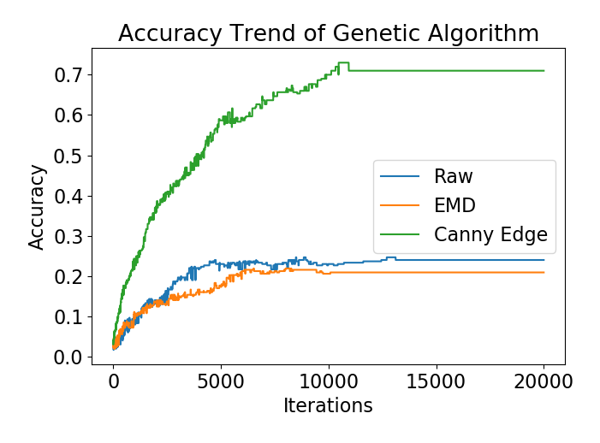
Co-location Accuracy
EMD
Raw
Event
Notes:
explain baselines and axis
looking for correlated events is effective in identifying co-located sensors

Slide 36
Related Work
Smith et al. - SigBED’12
Koc et al. - BuildSys’14
Bharttacharya et al. - BuildSys’15
Koh et al. - Arxiv’16
-Different Relations
-Require Perturbations

Slide 37
Maintenance
Comfort
Correctness
Context
Schema
Toolkit
Metadata
Mapping
Type Inference
Relation Inference
Plaster

Slide 38
AHU
Power Meter
Power Meter
hasPoint
AHU
feeds
Return Fan
Supply Fan
feeds
HVAC Zone
VAV
hasPart
VAV
Damper
Damper
Integrated into the ASHRAE Standard 223P for semantic tagging of building data
Notes:
After extracting the contextual information, we need to express it in a uniform format, i.e., a schema
Brick has an expressive and comprehensive vocabulary to represent the entities and their relationships\\ triplet predicate: e.g. \\ \\
it enables efficient and convenient queries.

Slide 39
Maintenance
Comfort
Correctness
Context
Schema
Toolkit
Metadata
Mapping
Type Inference
Relation Inference
Plaster
Notes:
We need a tool to automatically infer context and express the info following the schema

Slide 40
Plaster Architecture
Data Preparation
Feature Engineering
Model Training
Delivery
Building Adapter
Scrabble¹
Algorithm
Zodiac²
Prog. Synthesis³
Canonical ML
Smoothing
Data Feature Extractor
Evaluator
Utility
De-noising
Text Feature Extractor
Visualizer
Input Brickifier
Output Brickifier
¹[KBSMAG BuildSys’17] ²[BVNA BuildSys’15] ³[BHCOWW BuildSys’15]
Notes:
Plaster consists of reusable modules, and provides unified interfaces to construct algorithms.

Slide 41
Workflows
Input Brickifier
De-noising
Smoothing
Building Adapter
Scrabble
Output Brickifier
from plaster.utils import DataLoader
from plaster.utils import Dataset
from plaster.utils.preprocessing import denoise, smooth
from plaster.algorithms import BuildingAdapter
from plaster.algorithms import Scrabble
from plaster.workflow import Workflow
raw_data = DataLoader(building=‘rice’)
dataset = Dataset(raw_data, type=‘time_series’, preprocessing=[denoise,smooth])
model1 = BuildingAdapter(batch_size=1, threshold=0.6, ...)
model2 = Scrabble(batch_size=10, ..)
f1 = F1(average=‘macro’)
workflow = Workflow(dataset=dataset, model=[model1,model2], metric=f1, out_format=‘brick’)
Building Adapter
Input Brickifier
De-noising
Smoothing
Scrabble
Evaluator
Visualizer
Zodiac
Input Brickifier
Data Feature Extractor
Random Forest
Evaluator
Notes:
Enables: workflow\\benchmark\\Feature selection

Slide 42
Thoughts…
Data “Context” will be increasingly important
In the context of
Heterogeneous sources
Repurposed data
Missing metadata
...

Slide 43
Thesis Contributions
Automatic type inference
Complemented by a semi-automated method
Automatic relation inference
Functional connections between equipment
Co-location
Toolkit for mapping to Brick schema

Slide 44















What’s Next…
overheated room
Notes:
prioritize attention in data, building search engine\\
create context for all personal digital traces\\
secure and protect user's data since we can infer so much info

Slide 45










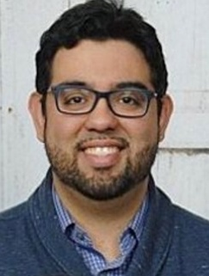



Kamin Whitehouse
Hongning Wang
Quanquan Gu
Arka Bhattacharya
Gabriel Fierro
David Culler
Jason Koh
Rajesh Gupta
Erin
Griffiths
Elahe
Soltanaghaei
Avinash
Kalyanaraman
Bharathan Balaji
Mani Srivastava
Joern Ploennigs
Jorge Ortiz
Aslak Johansen
Mikkel Kjaergaard
Joshua Gluck
Jingkun Gao
Mario Berges
Yuvraj Agarwal

Slide 46
Maintenance
Comfort
Correctness
Context
Schema
Toolkit
Metadata
Mapping
Type Inference
Relation Inference
Plaster
Questions?
Notes:
ack before finish

Slide 47
Backup Slides

Slide 48
Type Inference
What kind of sensor is this?
Notes:
next, lets
transition from type to function
future steps

Slide 49
Functional Relationships
How are these sensors related?

Slide 50
Maintenance
Comfort
Correctness
Metadata
Mapping
Context
Type Inference
Schema
Toolkit
Relation Inference
Plaster

Slide 51
Name
Timeseries
Type
SODA-ZONE2MTN
SODA-SW53_LGT
Co-location
SODA1R300_ART
Functional
Relation
SOD-AHU1-SFS
SODA1VAV4-CO2
Notes:
some primers: we exploit two common attributes of each sensor
We focus on *two kinds* of metadata
First is type\\, another is relationship\\ eg: \\ \\

Slide 52
Notes:
show two vavs

Slide 53
Edge Detection?

Slide 54
Transfer Learning Implementation
Name Clustering
Time Series Classification
K-mers features, for k=3,4
DPGMM clustering
Features
min
max
median
variance
…
SVM, Logistic Regression, and Random Forest
Zone-Temp2__RMI204
{zon, one, tem, emp, rmi, zone, temp}

Slide 55
Accuracy vs Coverage
Accuracy (Percentage)
Coverage (Labeled Percentage)
Notes:
setup the axis
talk about one, threshold on agreement to admit a label, the trend\\
then show\\ others and the specific pts
for an application, we probably need acc high enough, say 85,\\ but we see most of the cases end up with <85% points being labeled, so how to address the unlabeled sensors?

Slide 56
Combining Multiple Buildings as the Source
More Sources, More Promising!

Slide 57
Effect of Clustering on Accuracy
Classification Accuracy
Original
Building A
Notes:
Adding clustering alone is no better than LM
After adding p it gets better because xxx
LM+P is bad on A because loose estimation of r
Expalin setup and better legend would be easier

Slide 58
Effect of Label Propagation on Accuracy
Classification Accuracy
Original
Building A
Notes:
Adding clustering alone is no better than LM
After adding p it gets better because xxx
LM+P is bad on A because loose estimation of r
Expalin setup and better legend would be easier

Slide 59
Cross-Predictive Clustering
T
d
Time t-1
T < d
Time t
1
= w₁₂*
+ w₁₃*
+ w₁₄*
= w₁₂*
+ w₁₃*
+ w₁₄*
T
…...
2
w₁₁ w₁₂ w₁₃ w₁₄
3
4
Time t-1
Time t-2
Notes:
what leads to high-d\\ challenge?
a new metric

Slide 60
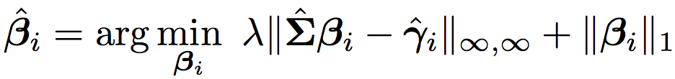
Cross-Predictive Clustering
The estimator:
Notes:
better explaination

Slide 61
Evaluation
204 streams from 51 rooms in one office building
4 different types
One week’s data
Notes:
how the baseline works
add clustering number on pts
this is better, should give better acc for the first 2
and see if it can work for things other than type.

Slide 62
Clustering Results
, d=204, T=336
Notes:
T and d for real data
highlight my approach
title

Slide 63
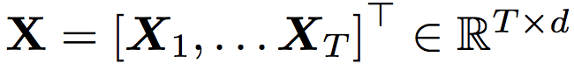
Cross-Predictive Clustering Models
The input:
(d time series of length T )
The vector autoregressive model:

Slide 64
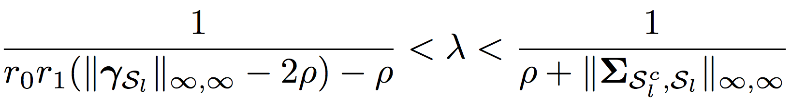
Cross-Predictive Clustering
The estimator:
Notes:
better explaination

Slide 65
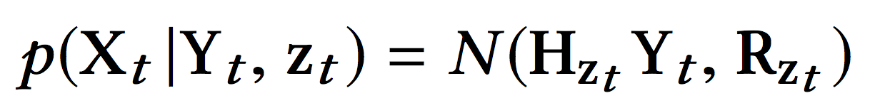
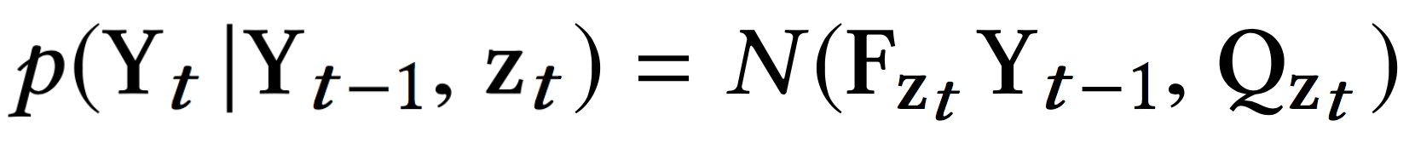
Switching Kinematic Model
z_{t-1}
z_{t}
z_{t+1}
latent states
y_{t-1}
y_{t}
y_{t+1}
latent true values
observed values
e.g., airflow sensor readings
x_{t-1}
x_{t}
x_{t+1}
Notes:
use k=2 as ex
what’s new here

Slide 66
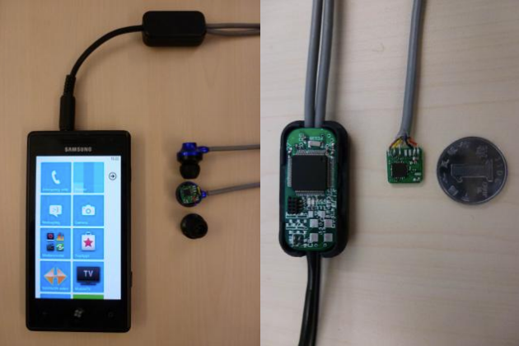

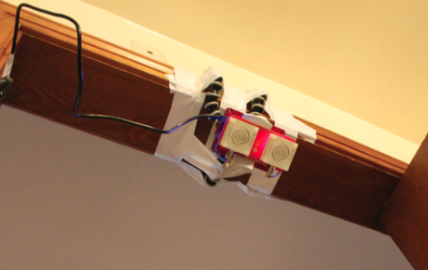
In the Thesis Other Work
Context
Type
BuildSys’15a, BuildSys’15b
CIKM’15, AISTATS’17
IPSN’12
SenSys’12a
SenSys’12b
Relation
BuildSys’13, UnderReview’19
Schema
BuildSys’16
IPSN’13
MobiSys’13
Toolkit
BuildSys’18
UbiComp’17
Plaster
Notes:
sw by far, also hw
released for framework

Slide 67
AHU
VAV
VAV
Notes:
why relation: we have type but not knowing which are in the same room
what they are sensing and why correlated
intuition: air from a to v, thus exhibit correlated events
challenge: how to detect and locate correlated events\\

Slide 68





Name
Data
Type
SODA-ZONE2MTN
?
SODA-SW53_LGT
Co-location
?
SODA1R300_ART
?
Functional
Relation
SODA-AHU9-SFS
?
SODA4VAV74-CO2
?
93%
8~11%
?

